Slide 1

Muncher
Less time deciding, more time eating...

Slide 2
What to eat? It’s not that Simple...
Motivation
I’ve been joking about creating this app for a while. My girlfriend is a rather picky eater, and I’m getting tired of spending 30+ minutes deciding where to eat whenever we want to eat out.
The idea is to make it like Tinder©, except for restaurants.
Naturally, all restaurants have already liked you. It’s always a match!
The ultimate goal is to help reduce decision time / mitigate decision paralysis.

Slide 4
Proposal
To develop and Android-based smart phone application that allows users to search, store, and select local restaurants.
The goal is to provide information that will aid people in selecting places to eat … in a reasonable amount of time.

Slide 5
App Features
Allow users to store favorite restaurants. Block undesired restaraunts.
Search for local restaurants, make suggestions.
Limit selection time.
Provide coupons when available.
Predict eating patterns?
Provide users info regarding their diet/spending?

Slide 6
Phone Requirements
Internet access.
Location services.
(Read and write memory?)

Slide 7
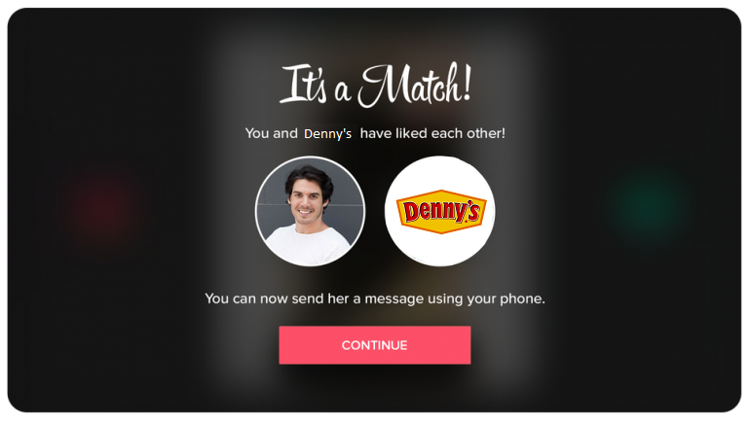
Mockups

Slide 8
Anticipated Deliverables
An app that can store favorite restaurants.
Track selection ratios.
An app that can search nearby restaurants.
Find hours.
Find menus.
Find ratings/reviews.
→ Search for coupons.
Track eating habits. Track spending habits.
Predict eating patterns. Help with dieting / dietary restrictions.

Slide 9
Project Timeline
An app that can store favorite restaurants.
Track selection ratios.
An app that can search nearby restaurants.
Find hours.
Find menus.
Find ratings/reviews.
→ Search for coupons.
Track eating habits. Track spending habits.
Eating patterns. Dieting / dietary restrictions.
Day 4
Day 7
Day 14
Day 15
Day 16
Day 17
Day 18
Day 24
Day 30

